Slide 2
We aim to encourage our pupils to learn about religious and non-religious worldviews.
Pupils will have opportunities to celebrate the diversity of the wider community in County Durham, including their beliefs, traditions, culture, language and history.
Pupils will be encouraged to ask challenging
questions about meaning and purpose in life, beliefs about God, ultimate reality, issues of
right and wrong and what it means to be human.

Slide 3
Enables pupils to develop their own sense of identity and belonging.

Slide 4
Enables pupils to explore their own beliefs (whether they are religious or not), ideas, feelings, experiences and values in the light of what they learn.

Slide 5
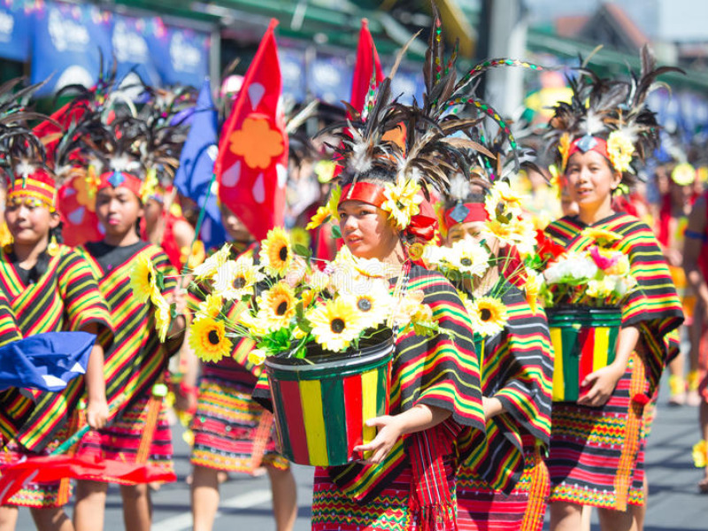
Promotes respect for the right of others to hold different beliefs, values and ideas.

Slide 6
Offers opportunities for personal reflection and pupils’ spiritual, moral, social and cultural development.

