Slide 2
We aim to teach our pupils the important role of history in daily life and provide children with opportunities to better understand significant time periods in history, and our local history.
To understand historical chronology, so that our pupils can make connections between different periods from the past and the present.
To enable our pupils to ask perceptive questions, think critically, weigh evidence, sift arguments, and develop perspective and judgement.

Slide 3
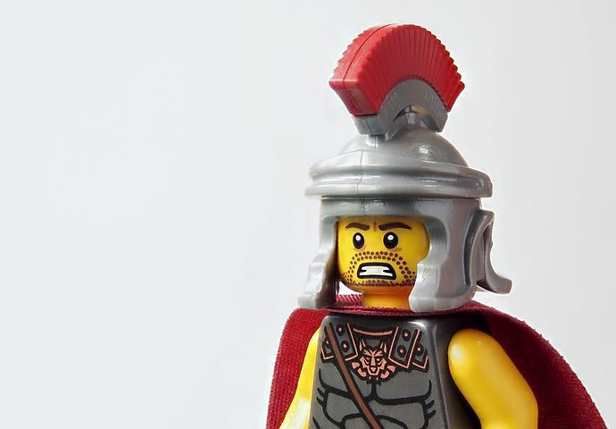
History is a key subject to engage pupils’ creative and critical thinking about change, both locally and globally, and the implications for the future.

Slide 4
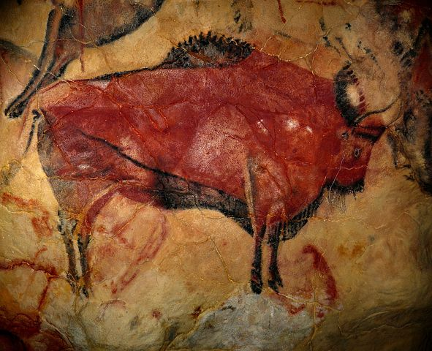
Pupils’ historical knowledge and skills are developed through analysing and judging different sources of evidence and understanding its importance when piecing together the past.

Slide 5
History encourages pupils to explore how the world has changed, the processes involved and the impact and legacy of change.

Slide 6
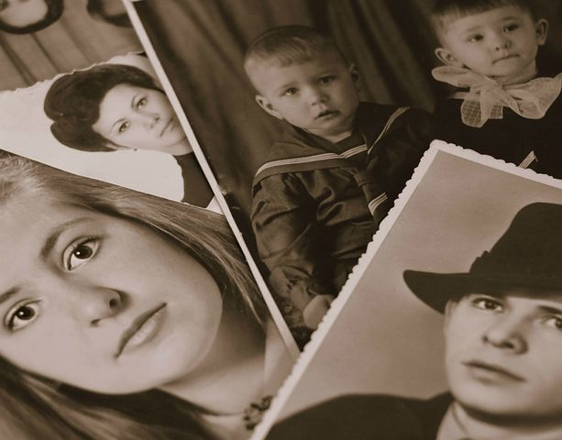
History teaches pupils to recognise similarities and differences between periods in history and see how the past has shaped the present.

Slide 7
History inspires pupils’ curiosity, leading them to ask relevant questions and think critically when searching for answers.

