Slide 2
We aim to provide children with opportunities to better understand both the physical properties of Earth's surface and the human societies spread across it.
We help our pupils understand the importance of interactions between physical and human processes, and of the formation and use of landscapes and environments.
We aim to inspire our pupil’s curiosity and fascination about the world and the people in it

Slide 3
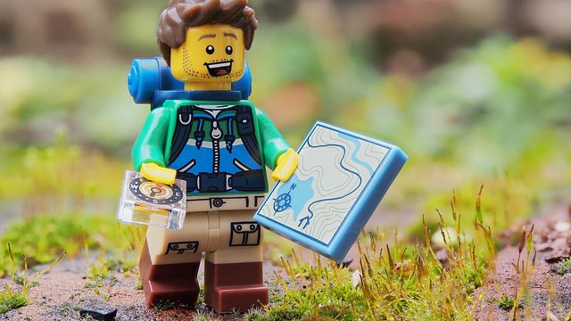
The geography that children learn is brought `alive’ for them through investigating and asking questions about the world.

Slide 4
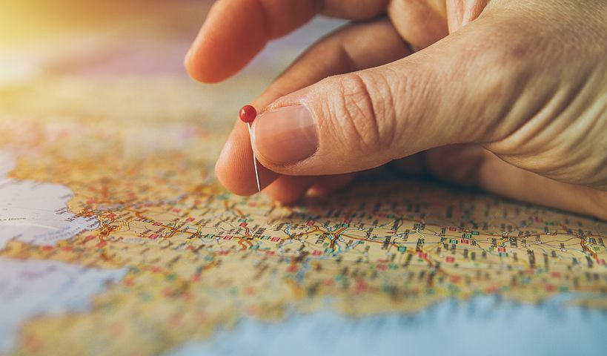
Geography teaches pupils to appreciate the diversity evident in the world, through learning about similarities, differences and how we live interdependently.

Slide 5
Geography develops pupils’ role as stewards of the planet Earth, at local, national and global scale

Slide 6
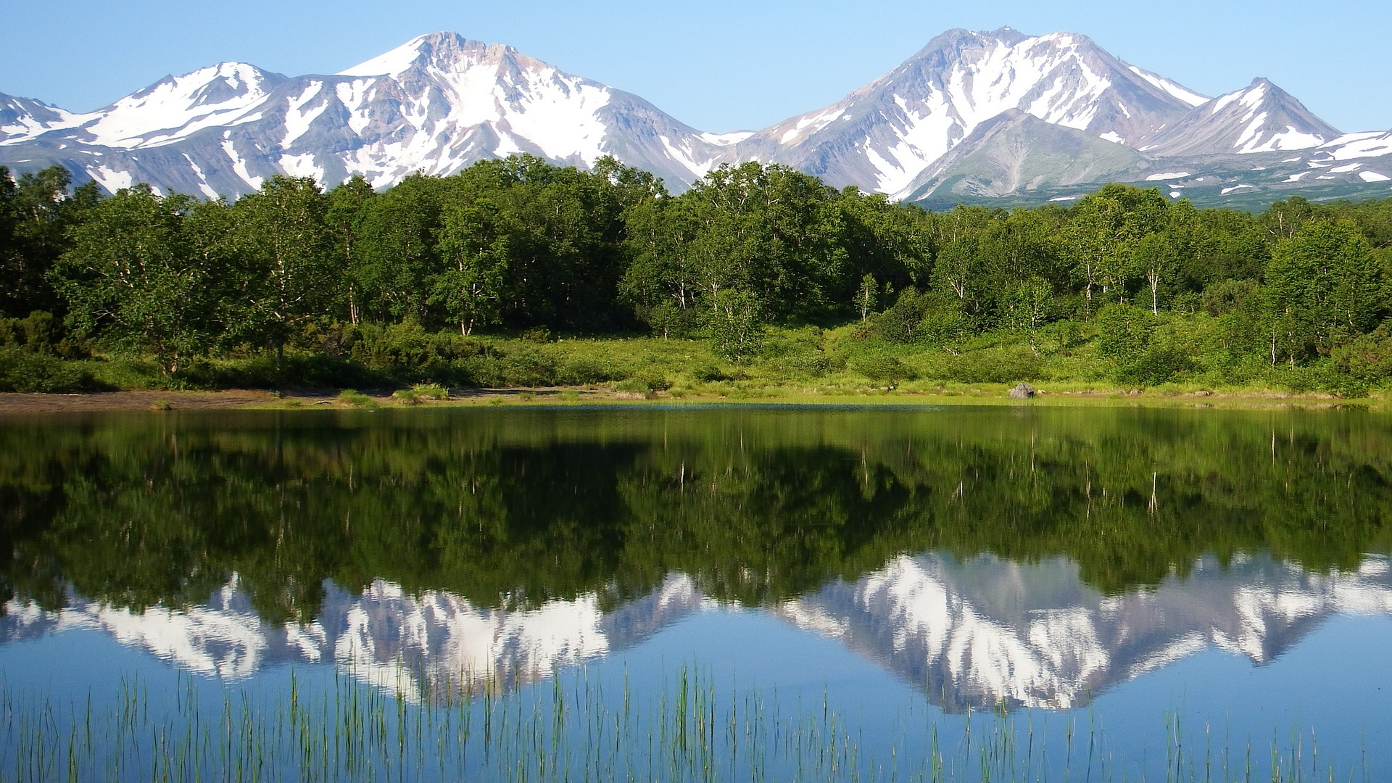
Geography helps pupils recognise how and why changes to places and the environment happen and affect us, both as a result of natural processes and through human activity.

Slide 7
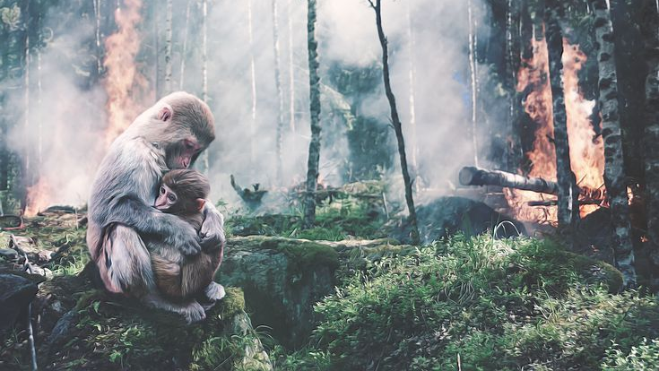
Geography is a key subject to engage pupils’ creative and critical thinking about change, both locally and globally, and the implications for the future.

