Slide 1
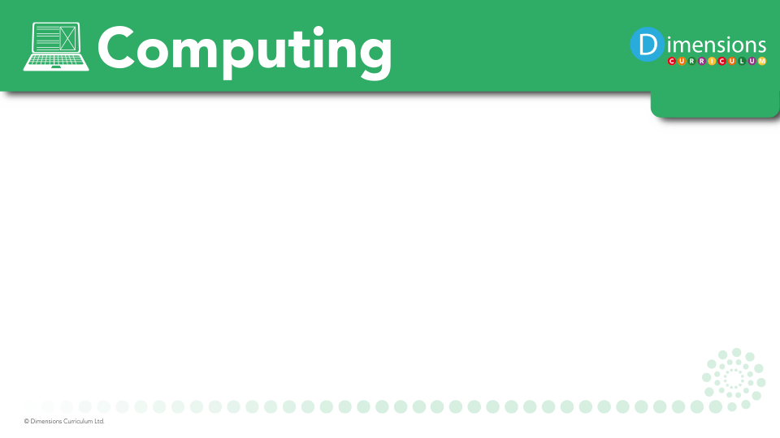


Slide 2
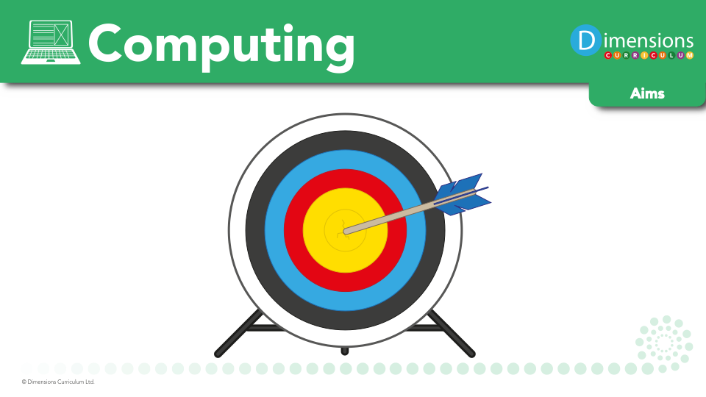
We aim to teach our pupils how to keep safe online, and where to go for help and support.
We aim to equip our pupils with the skills and knowledge to more actively participate in a rapidly changing technological world.
We believe that our pupils’ critical thinking and analytical skills are developed through computing.

Slide 3

Computing encourages pupils to use logical reasoning to predict the behaviour of simple programs.

Slide 4

Computing nurtures pupils’ collaboration skills, as they work together and support one another in their learning.

Slide 5

Computing develops pupils’ skills in using technology to create, organise, store, manipulate and retrieve digital content.

Slide 6
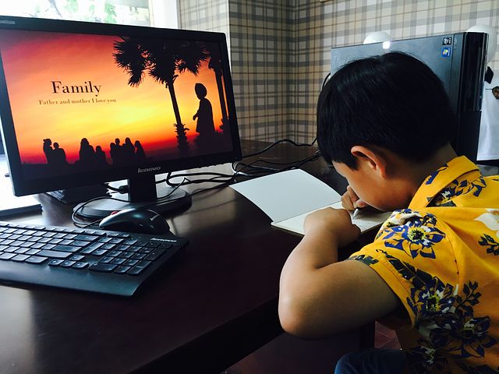
Computing teaches pupils how to flourish in a connected world, developing their sensitivity to others online, treating them with respect, and showing respect for their privacy.

Slide 7

Computing helps pupils to express themselves and develop their ideas through information and communication technology, at a level suitable for the future workplace and as active participants in a digital world.

