Slide 1


Put your school logo here

Slide 2
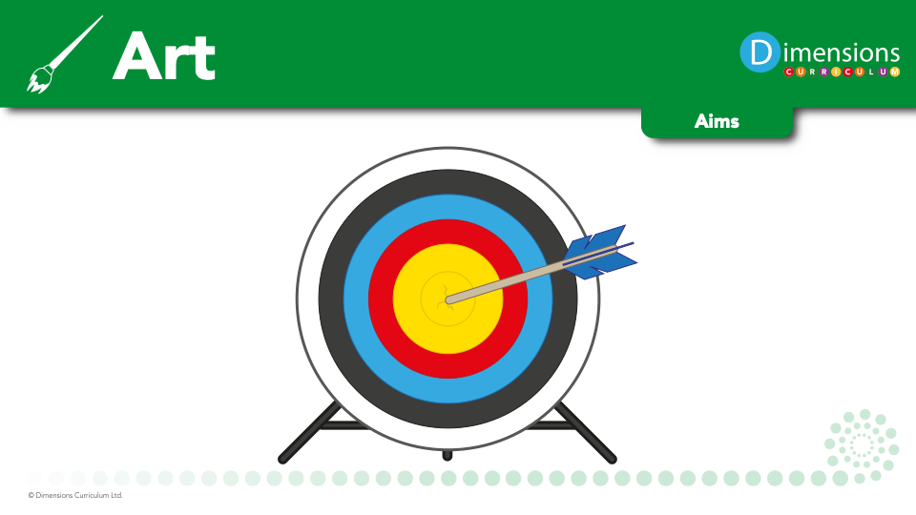
We aim to engage, inspire and challenge pupils, equipping them with the knowledge and skills to experiment, invent and create their own works of art.
Our pupils will be taught how art and design both reflect and shape our history, and contribute to the culture, creativity and wealth of our nation.
Our pupils will be given opportunities to think critically and develop a more rigorous understanding of art and design.

Slide 3

Art engages, inspires and challenges pupils, equipping them with the knowledge and skills to experiment and invent.

Slide 4
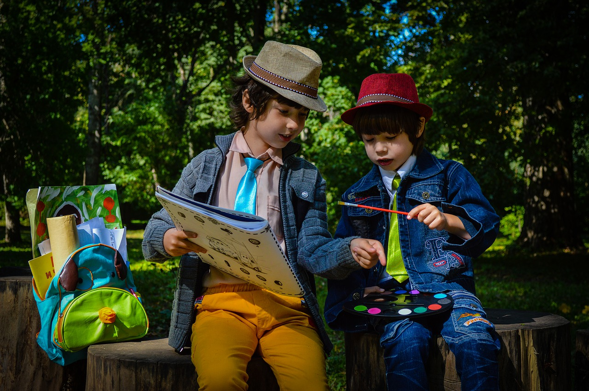
Art is an important part of developing pupils’ ability to express their individual creativity, working both individually and collaboratively with others.

Slide 5

Art takes pupils to other worlds, cultures and times, as they explore ideas in the work of a variety of artists.

Slide 6
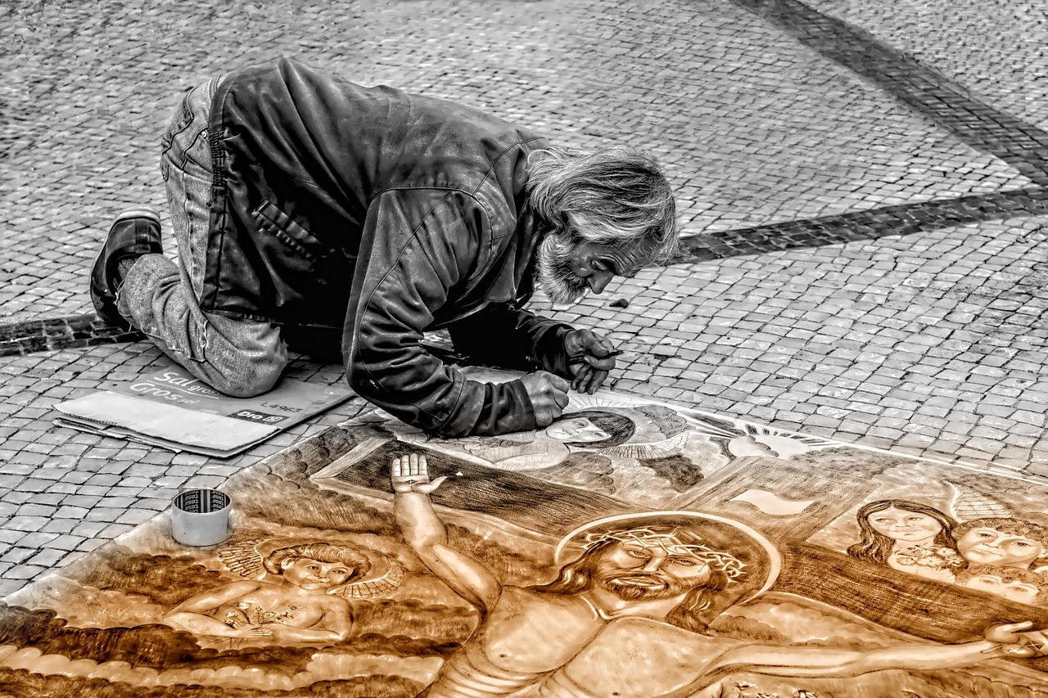
Through art, pupils produce their own, original creative work, exploring their ideas and recording their experiences.

Slide 7
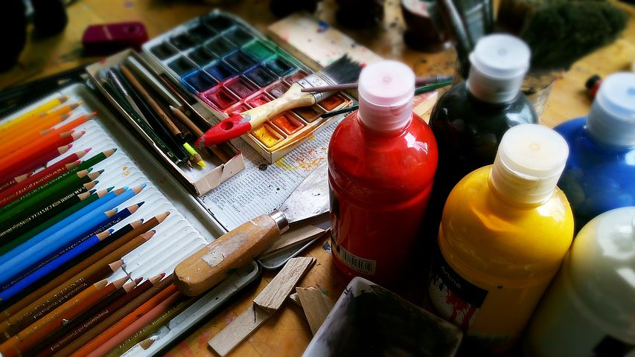
Art creates opportunities for our pupils to explore different materials and develop their own ideas of how to use them effectively

